Slide 1
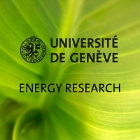
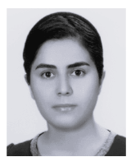


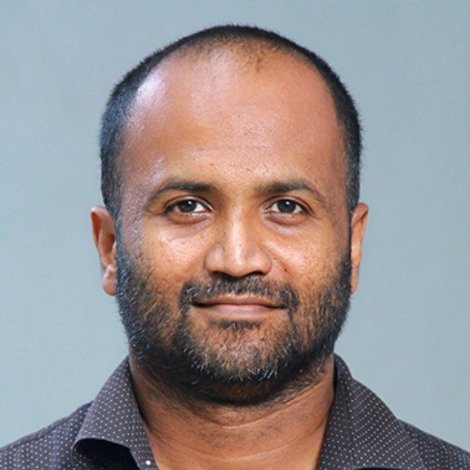




Net-Zero transition in Africa
Fatemeh
Ian
Mackenzie
Praveen
PRISMA summer school, 14-19 June 2026, Geneva, Switzerland

Slide 2
Introduction
Set of scenarios (763)
Emissions
Energy consumption
per capita
Selected metrics for
robust decision making
Metrics | Low CO2 emission | High CO2 emissions
High energy per capita | Sustainability | Cabon intensive growth
Low energy per capita | Low carbon & energy poverty | High carbon & energy poverty

Slide 3
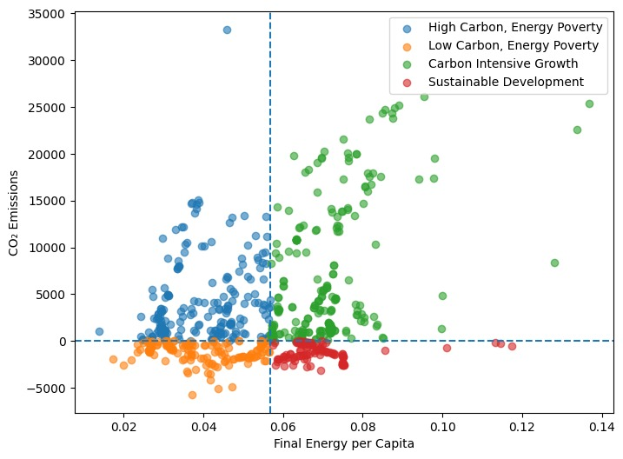
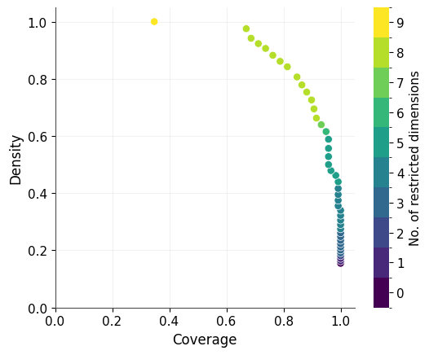
PRIM Analysis
Scenario Quadrants
228 (30%)
264 (35%)
153 (20%)
118 (15%)

Slide 4

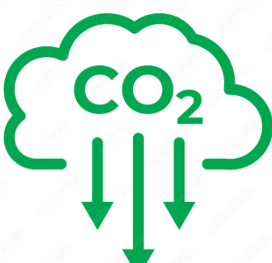
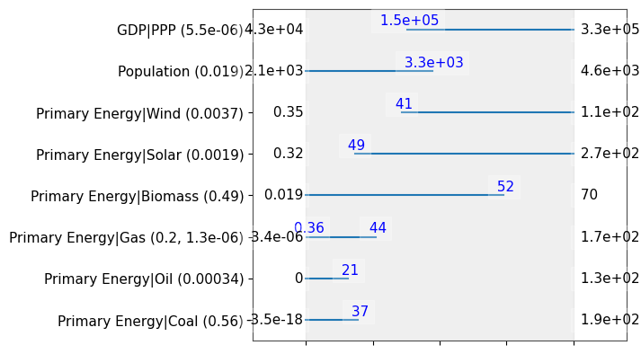
Sustainable Development Corridor
Economic growth remains strong.
Solar and wind deployment reach substantial levels.
Gas acts as a transition fuel (limited presence)
Near complete Coal phase-out
Population growth remains manageable (low-medium)
Density = 84% , Coverage =81%

Slide 5

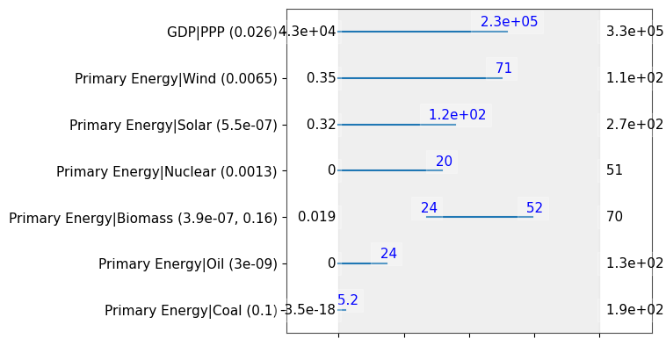
Low Carbon, Energy Poverty
Lower economic development
Near phase-out of coal.
Lower energy from wind/solar
Lower energy from oil.
Continued reliance on traditional fuels (biomass).
Density =82% , Coverage = 74%
Notes:
low emissions alone do not guarantee development.

Slide 6
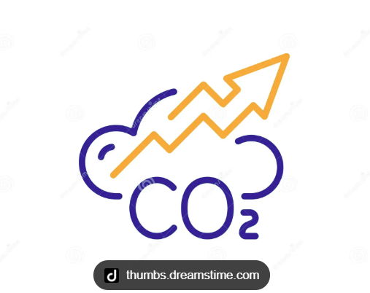
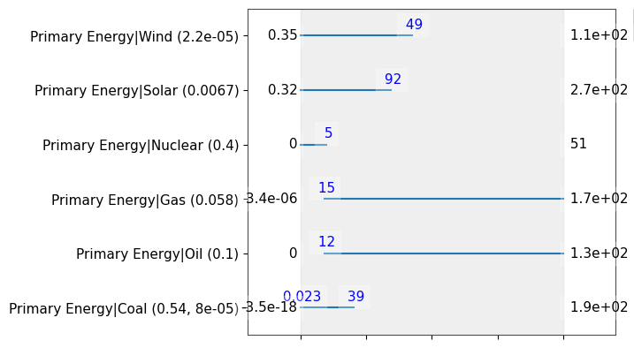
High Carbon, Energy Poverty
Insufficient wind deployment
Continued use of Oil & Gas.
Inadequate solar and nuclear contribution
Density =80% , Coverage = 65%

Slide 7
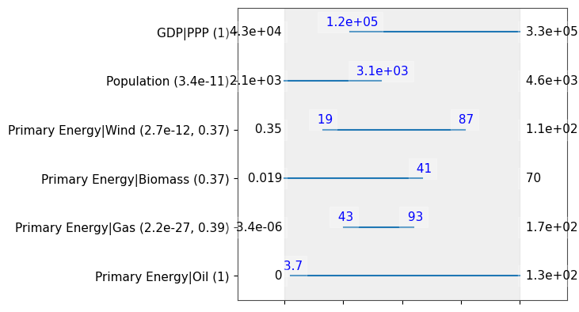
Carbon Intensive Growth
Economic growth remains strong.
Medium presence in wind energy
Higher gas compared to Sustainable scenario
Population growth remains (low-medium)
Density = 100% , Coverage =60%
Notes:
Renewables alone do not guarantee decarbonization. The key distinction is the structure of the energy system, particularly the role of natural gas and the scale of renewable deployment

Slide 8

Conclusion
Africa's challenge is not simply reducing emissions.
The scenario discovery analysis shows that low-emission futures can still result in persistent energy poverty if modern energy deployment remains inadequate.
Sustainable development emerges only when economic growth is accompanied by large-scale deployment of modern low-carbon energy sources, particularly solar and wind, while avoiding excessive dependence on fossil fuels.

